Slide 1
CHAPTER THREE
Basic Organic Products

Slide 2
Basic Organic Products
What are organic products?
➲ How organic products are obtained?
➲ Why we need to study organic products?
➲ What are the applications of organic products?

Slide 3
3.1 Introduction to Industrial Organic Synthesis
Organic synthesis is a major facilitator for the chemical industry and a significant contributor to society, applications being found in the;
pharmaceuticals,
 fine chemicals,
 agrochemicals,
 specialty chemicals,
 electronics and other related industries.
Industrial organic synthesis is manufacturing process of different organic compounds industrially.

Slide 4
3.2 Manufacture of Methanol and Isopropanol
3.2.1 Industrial Preparation of Methanol (CH₃OH)
CH₃OH is a common industrial chemical that has been used as an alternative blended liquid transportation fuel & under consideration for wider use.
In Asia, CH₃OH is almost exclusively used to produce the intermediate chemicals such as formaldehyde as input to urea formaldehyde composite wood adhesive.
On industrial scale CH₃OH is prepared from a mixture of CO & H₂.

Slide 5
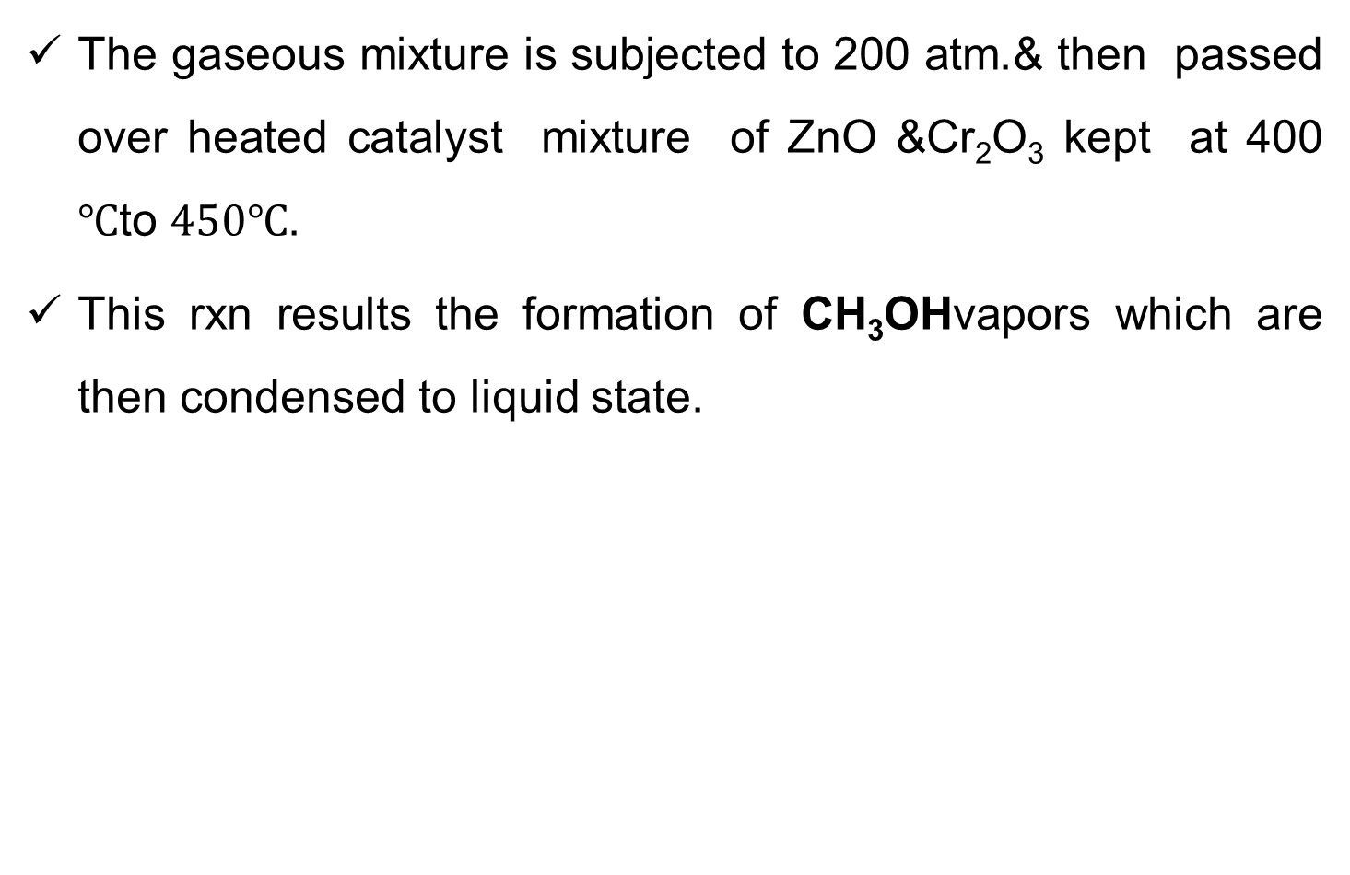

Slide 6
Properties of Methanol
Physical Properties
It is a colorless liquid.
It is highly volatile and less viscous.
Its boiling point is 64.7 ^{O}C.
It is a poisonous liquid & it is miscible in water.
Chemical Properties
Ester Formation:
Reaction With Halogen Acid (in the presence of ZnCl₂)
Oxidation (Formation of formaldehyde): In the presence of K₂Cr₂O₇ in acidic medium, on heating, methanol is oxidized to formaldehyde.

Slide 7
3.2.2 Manufacture of Isopropropanol
Isopropyl alcohol/propan-2-ol/2-propanol (C₃H₈O) (also known as rubbing alcohol) is a colorless, flammable chemical compound with a strong odor.
It is the simplest example of a secondary alcohol.
C₃H₈O is produced by combining H₂O & propene through two processes as shown in the reaction shown below.
i) Indirect hydration: propene reacts with H₂SO₄ to form a mixture of sulfate esters.
Subsequent hydrolysis of these esters produces isopropyl alcohol.

Slide 8
These processes give predominantly isopropyl alcohol rather than 1-propanol b/c the addition of H₂0 or H₂SO₄ to propene follows Markovnikov's rule.
ii) Direct hydration: Involve reaction of propene with water, either in gas or liquid phases, at high pressures in the presence of acidic catalysts.

Slide 9
3.3.Manufacture of Formaldehyde & Acetaldehyde
3.3.1 Manufacture of Formaldehyde (Methanal)
It is the simplest aldehyde with the formula CH₂O.
3.3.1.2 Synthesis and industrial production of Formaldehyde
It is produced industrially by the catalytic oxidation of methanol.
The most common catalysts are Ag metal or a mixture of Fe & molybdenum or vanadium oxides.
It can also naturally occur in the environment where carbon, hydrogen and oxygen exist by the action of sunlight & it becomes part of smog.

Slide 10
Natural processes in the upper atmosphere may contribute up to 90 % of the total formaldehyde in the environment.
It is also formed as an intermediate in the oxidation (or combustion) of methane and other carbon compounds, e.g. forest fires, in automobile exhaust, and in tobacco smoke.
Aqueous solutions of formaldehyde are referred to as formalin.
Formalin is used as disinfectant & preservation of organic specimens in biological system.

Slide 11
3.3.2 Manufacture of Acetaldehyde
Acetaldehyde (CH₃CHO), also called ethanal, is an aldehyde used as a starting material in the synthesis of 1-butanol (n-butyl alcohol), ethyl acetate, perfumes, flavorings, aniline dyes, plastics, synthetic rubber, & other chemical compounds.
Pure acetaldehyde is a colorless.

Slide 12
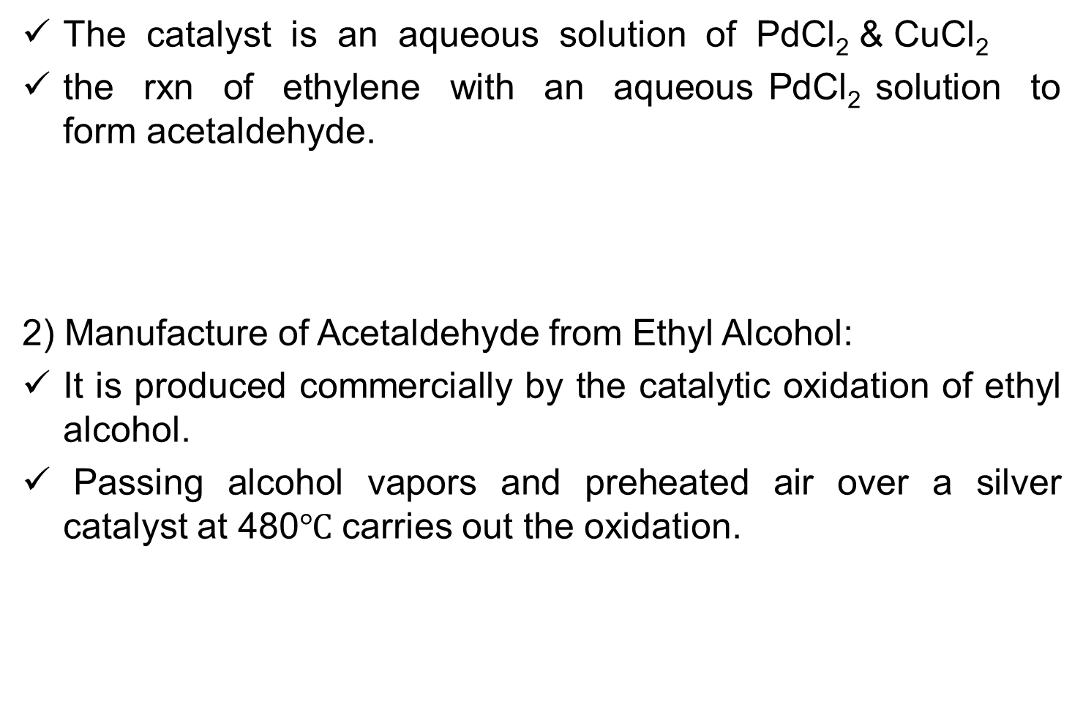

1) Manufacture of Acetaldehyde by Oxidation of Ethylene

Slide 13
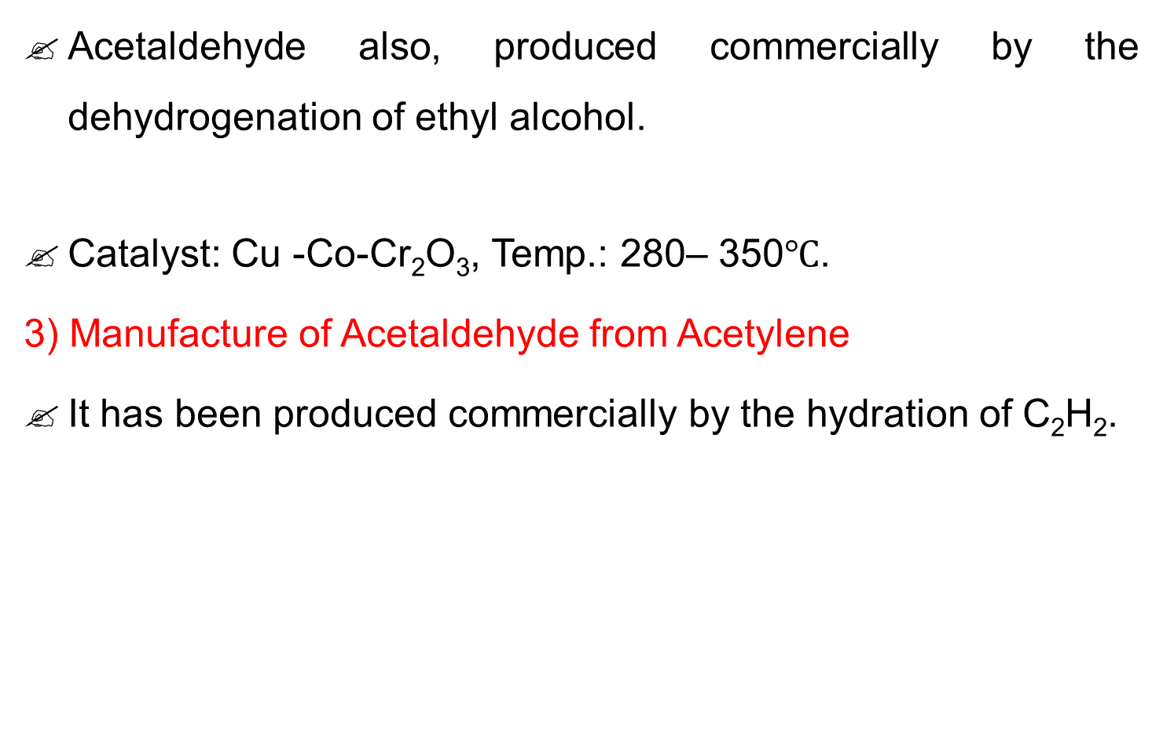
contd

Slide 14

3.4. Manufacture of Acetic acid
3.4.1Manufacture of acetic acid by Methanol carbonylation
Most acetic acid (CH₃COOH) is produced by methanol carbonylation.
In this process, CH₃OH and CO react to produce acetic acid according to the chemical equation:
The process involves iodomethane as an intermediate, and occurs in three steps.
A catalyst, metal complex, is needed for the carbonylation.

Slide 15
Manufacture of Acetic acid
3.4.2 Manufacture of CH₃COOH by Acetaldehyde oxidation
similar catalysts as are used for butane oxidation, the oxygen in air to produce acetic acid can oxidize acetaldehyde.
3.4.3 Manufacture of CH₃COOH by anaerobic fermentation
Anaerobic bacteria of the genus Clostridium, can convert sugars to CH₃COOH directly, without using ethanol as an intermediate.
The overall chemical rxn:

Slide 16

Manufacture of Acetic acid
3.4.4 Manufacture of acetic acid by Oxidative fermentation
CH₃COOH bacteria of the genus Acetobacter have made CH₃COOH, in the form of vinegar.
Given sufficient oxygen, these bacteria can produce vinegar from a variety of alcoholic foodstuffs.
Commonly used feeds include apple cider, wine, and fermented grain, malt, rice, or potato mashes.
The overall chemical reaction facilitated by these bacteria is:

Slide 17
Properties of acetic acid
It is a colorless liquid that has distinctive sour taste & pungent smell.
It is classified as a weak acid, is highly dangerous to skin.
It is one of the simplest carboxylic acids.
It is an important chemical reagent & industrial chemical, mainly used in the production polyvinyl acetate for wood glue, as well as synthetic fibers and fabrics.
In households, dilute CH₃COOH is often used in descaling agents.
Dilute CH₃COOH produced by natural fermentation is called vinegar.
CH₃COOH is produced industrially both synthetically and by bacterial fermentation.

Slide 18

3.5. Manufacture of Acetone
3.5.1 Manufacture of acetone
Cumene process: Benzene is alkylated with propylene and the resulting cumene (isopropylbenzene) is oxidized by air to give phenol and acetone:
Other direct oxidation of propylene or the hydration of propylene to give 2-propanol, which is oxidized to acetone.
Besides, Small amounts of acetone are produced in the body by the decarboxylation of ketone bodies.
It is a by product of fermentation in the distillery industry.

Slide 19
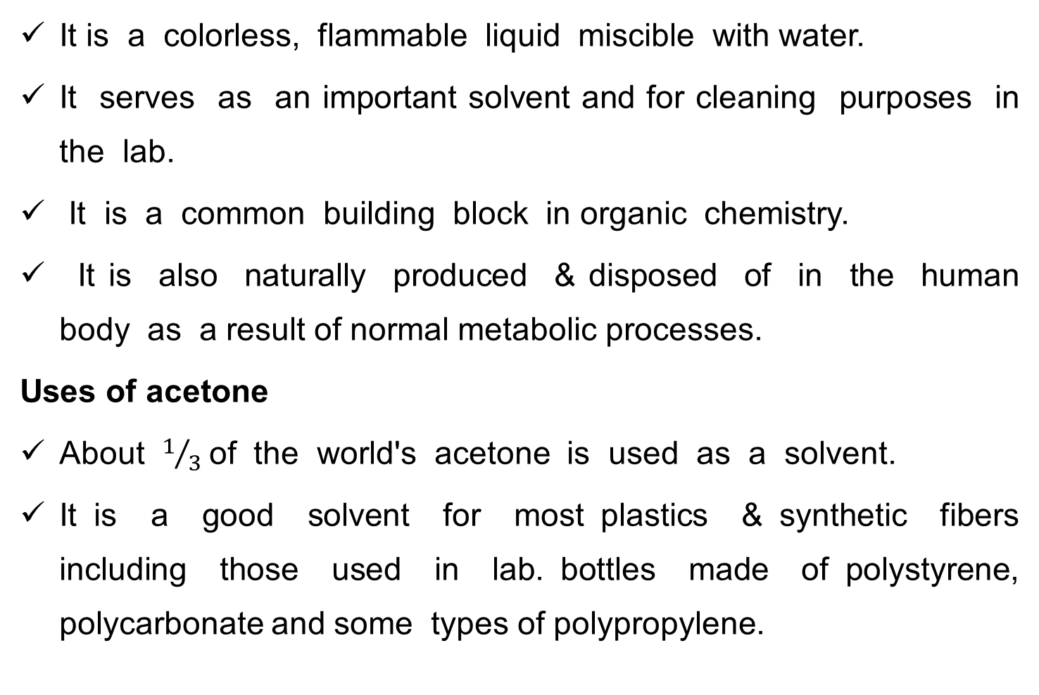
Properties of Acetone (CH₃)₂CO)

Slide 20
Uses of acetone
It is used as a solvent in pharmaceutical industry & as a denaturation agent in denatured alcohol.
In the laboratory it is used as a polar aprotic solvent in a variety of organic reactions, such as S_{N}2 reaction.
The use of acetone solvent is also critical for the Jones oxidation.
It is a common solvent for rinsing laboratory glassware because of its low cost & volatility.
It is presented in a variety of general medical & cosmetic applications and is also listed as a component in food additives & food packaging.

Slide 21
3.6. Manufacture of Phenol and Styrene
Phenol (carbolic acid), is an organic compound with the chemical formula C₆H₅OH.
It is a white crystalline solid.
The molecule consists of a phenyl (-C₆H₅), bonded to a hydroxyl (-OH) group.
Because of phenol's commercial importance, many methods have been developed for its production.
The main route being practiced presently involves the partial oxidation of cumene (isopropylbenzene) via the Hock rearrangement:

Slide 22

3.6. Manufacture of Phenol and Styrene
The first commercial route begins with the reaction of strong base with benzenesulfonate:
Uses of phenol
Condensation with formaldehyde gives phenolic resins, the most famous of which is Bakelite.
Hydrogenation of phenol gives cyclohexanone, an intermediate route to nylon.
Non-ionic detergents are produced by alkylation of phenol to give the alkylphenols, which are then subjected to ethoxylation.

Slide 23
Uses of Phenol
Phenol is also a versatile precursor to a large collection of drugs, most notably aspirin but also many herbicides and pharmaceuticals.
It is also used as an oral anesthetic/analgesic, commonly used to temporarily treat pharyngitis.
Phenol was widely used as an antiseptic, especially as carbolic soap.

Slide 24
Manufacture of Styrene (vinyl benzene)
Styrene, also known as vinyl benzene, is an organic compound with the chemical formulaC₆H₅CH=CH₂.
This derivative of benzene is a colorless oily liquid that evaporates easily.
It has a sweet smell, although high concentrations confer a less pleasant odor.
Styrene is the precursor to polystyrene and several copolymers.
Styrene is produced in industrial quantities from
ethylbenzene, which is in turn prepared on a large scale by alkylation of benzene with ethylene.

Slide 25
Styrene is most commonly produced by the catalytic dehydrogenation of ethyl benzene.
Ethylbenzene is mixed in the gas phase with 10–15 times of its volume in high-temperature steam, and passed over a solid catalyst bed.
Most ethylbenzene dehydrogenation catalysts are based on
iron (III) oxide, promoted by several percent potassium
oxide or potassium carbonate.
Steam serves several roles in this reaction.
It is the source of heat for powering the endothermic reaction,
And it removes coke that tends to form on the iron oxide catalyst through the water gas shift reaction.

Slide 26

Manufacture of Styrene via ethylbenzenehydroperoxide
Commercially, styrene is also co-produced with propylene oxide.
In this process ethylbenzene is treated with oxygen to form the ethylbenzene hydroperoxide.
This hydroperoxide is then used to oxidize propylene to propylene oxide.
The resulting 2-phenylethanol is dehydrated to give styrene:

